Slide 1


Software module development for detection of Triple interactions within biological networks considering time-delays
Novosibirsk state university
Department of mathematics and mechanics
Applied mathematics and informatic
Artemiy Firsov
ICG, molecular-genetic systems laboratory
Scientific advicor: Igor Titov, Candidate of Physico-Mathematical Sciences
19.10.2016

Slide 2
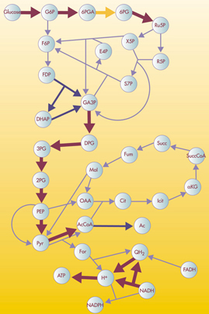
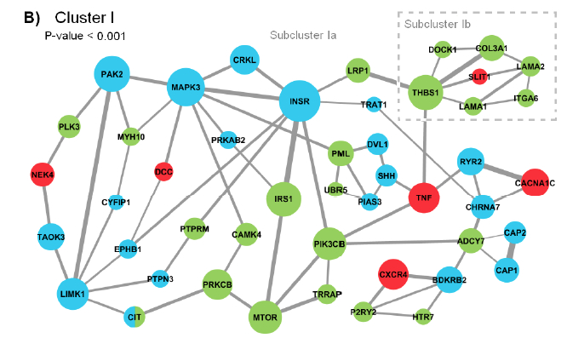
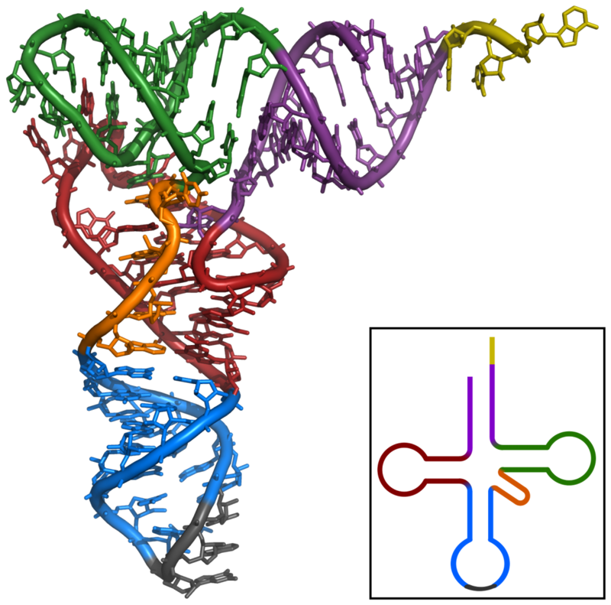
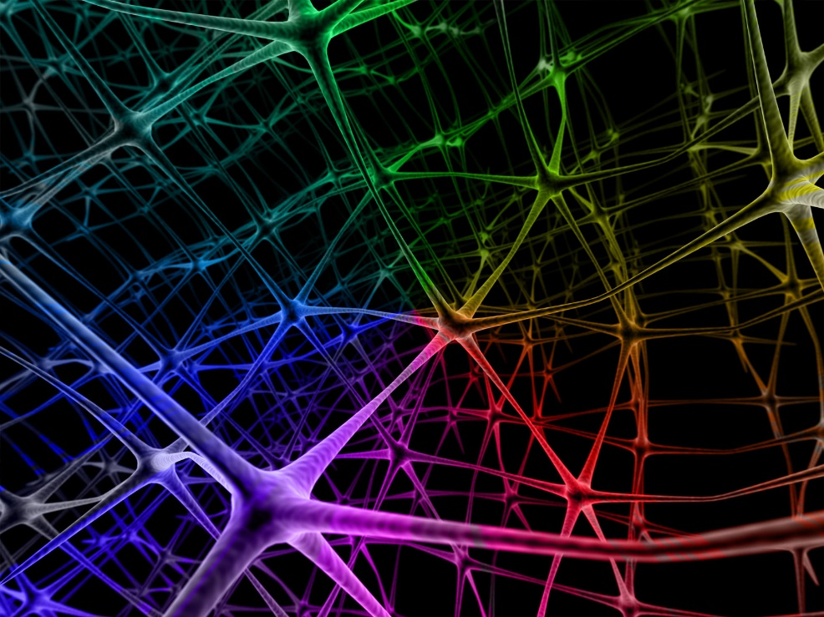
Applicable scope
Reconstruction of:
Metabolic networks
Gene networks
Neural networks
Spatial contacts in bio-polymers (RNA, chromatin, proteins)
etc
1
2￼
4￼
3￼
2￼

Slide 3
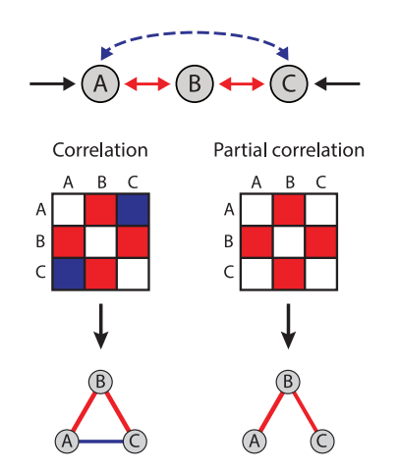
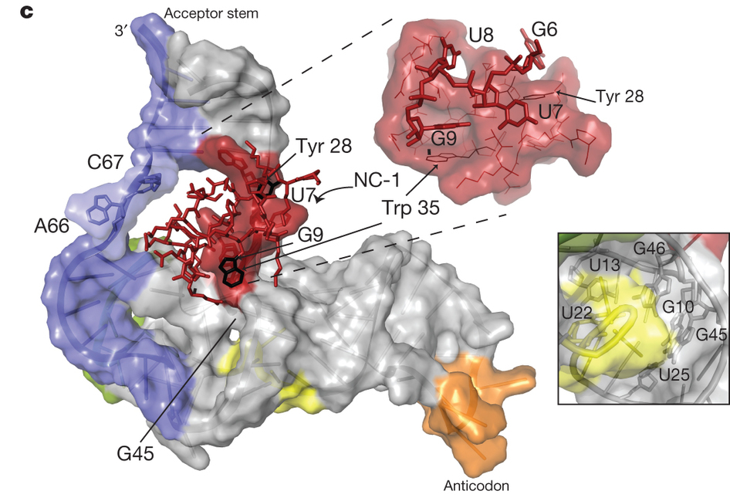
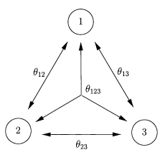
Types of interactions
Pairwise
High-order
Direct and indirect
Direct
3￼
Inferring Pairwise Interactions from Biological Data Using Maximum-Entropy Probability Models Richard R. Stein, Debora S. Marks , Chris Sander, s. PLoS Comput Biol 11(7): e1004182. doi:10.1371/journal. pcbi.1004182

Slide 4
Triple interactions
Triple interactions exist in real biological sysytems
Leader algorithms in DREAM Challenge take into account triple interactions
Analysis of higher-order neuronal interactions based on conditional inference, Robert Gütig, Ad Aertsen, Stefan Rotter.
Global quantitative modeling of chromatin factor interactions. Zhou J, Troyanskaya OG.
Finding High-Order Correlations in High-Dimensional Biological Data. Xiang Zhang, Feng Pan, and Wei Wang Department of Computer Science University of North Carolina at Chapel Hill
DTW-MIC Coexpression Networks from Time-Course Data. Samantha Riccadonna , Giuseppe Jurman, Roberto Visintainer , Michele Filosi , Cesare Furlanello
4￼

Slide 5
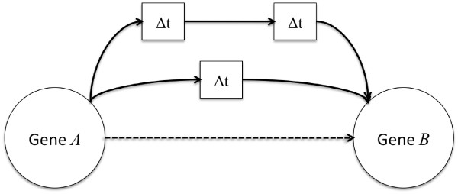
Time-delayed interactions
Often the result of interaction can be seen after some time
Considering time-delays allows to reconstruct the interactions timeline
TimeDelay-ARACNE: Reverse engineering of gene networks from time-course data by an information theoretic approach. Zoppoli P., Morganella S., Ceccarelli M. BMC Bioinform
MIDER: Network Inference with Mutual Information Distance and Entropy Reduction.
Alejandro F. Villaverde, John Ross, Federico Morán, Julio R. Banga
5￼

Slide 6
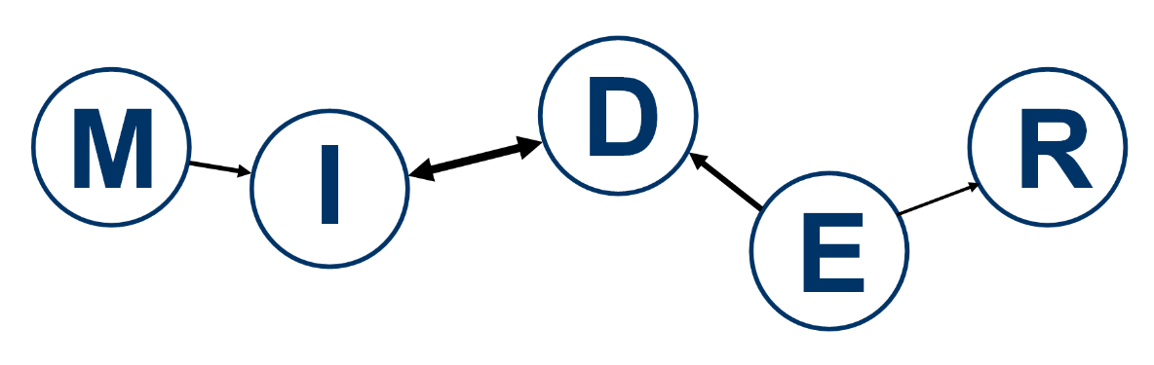
Topical solutions
Global Quantitative Modeling of Chromatin Factor Interactions
Detects direct interactions
Considers time-delays
Open-sourced in MatLab
Does not consider triple interactions
Detects direct interactions
Does not consider time-delays
No open-sourced implementation
Considers triple interactions
Villaverde, A., Ross, J., Morán, F., and Banga, J.R. (2014). MIDER: network inference with mutual information distance and entropy reduction. PloS ONE 9(5):e96732
Global quantitative modeling of chromatin factor interactions. Zhou J, Troyanskaya OG. PLoS Comput Biol. 2014 Mar 27;10(3):e1003525. doi: 10.1371/journal.pcbi.1003525. eCollection 2014.
6￼

Slide 7
Регуляризация Шмидта
7￼

Slide 8
Goal
Develop the software module for detection of triple interactions in biological networks considering time-delays
Issues
Implementation of triple interactions detection algorithm based on MIDER algorithm
Changing time-delay consideration algorithm to DTW
Optimizations of the algorithm (Schmidt’s regularization, GPU utilization)
Tests on DREAM Challenge
8￼

Slide 9
Requirements
Open-source library
Performance for 1000 elements capacity gene network no more than 1 hour
Consider triple interactions, time-delays
Ability to scale it to higher order interactions
Need to be done and tested till 06/01/2018 (done and tested on fake data till 04/01/2017)
Resources
Me
Open-sourced implementations, scientific articles
Cluster in ICG
PubMed database
Dream Challenge platform for testing

Slide 10
Steps
Integrate triple interactions in MIDER project
Change time-delay algorithm to DTW
Test algorithm on fake data
Test algorithm on sets of real biological data of 10-100 capacity
Optimize algorithm performance with Schmidt’s regularization, GPU utilization, etc
Testing, writing and publishing an article, participating in conferences

Slide 11
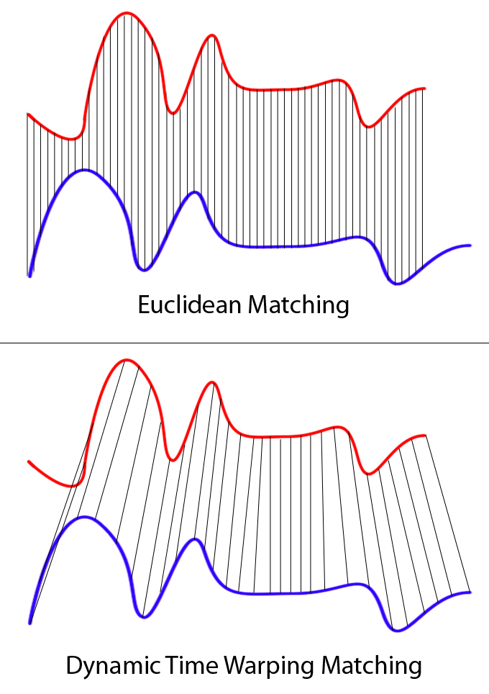

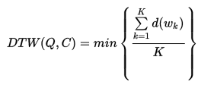
Алгоритм DTW
11￼

